Slide 1

Training Neural Networks
Presented by:
Elizer Ponio Jr.
Department of Computer Science
College of Computing and Information Technologies

Slide 2
Outline
What is Backpropagation?
Backpropagation Example

Slide 3
Definition
Backpropagation is the process of adjusting the weights of a neural network by analyzing the error rate from the previous iteration.
Hinted at by its name, backpropagation involves working backward from outputs to inputs to figure out how to reduce the number of errors and make a neural network more reliable.

Slide 4
Definition
Backpropagation computes the gradients of a loss function with respect to the weights in a neural network.
This gradient is then used to update the weights in a training step in an optimization algorithm like gradient descent

Slide 5





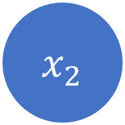

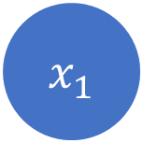


$$wx+b$$
$${ x}_{1}$$
$$w$$
Activation function
$$w$$
$$w$$
$$\hat{p}$$
Activation function
Loss function
$$w$$
$$w$$
$${ x}_{2}$$
Activation function
$$w$$
Calculate Loss
Input Layer
Hidden Layer
Output Layer
FORWARD PASS (MAKE PREDICTION)
Notes:
For example we have a neural network with an input layer, a hidden layer and an output layer
In each neuron, we have different weights and then we multiply the weights with the input x and maybe ad a bias
The way it works is that we do a forward pass where we apply all those neurons and then calculate the loss at the very end and then we apply the back propagation algorithm

Slide 6
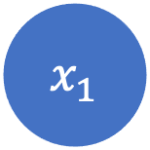
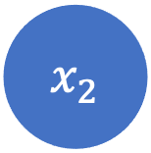
$${ x}_{1}$$
$$w$$
Activation function
$$w$$
$$w$$
$$\hat{p}$$
Activation function
Loss function
$$w$$
$$w$$
$${ x}_{2}$$
Activation function
$$w$$
Calculate Loss
Input Layer
Hidden Layer
Output Layer
BACKPROPAGATION (Adjust all weights to reduce loss)
Notes:
Which means we apply a backward pass and can then calculate the gradients with a special method.
And then with this gradient we can update the weights which means our neural network learns and gets better

Slide 7

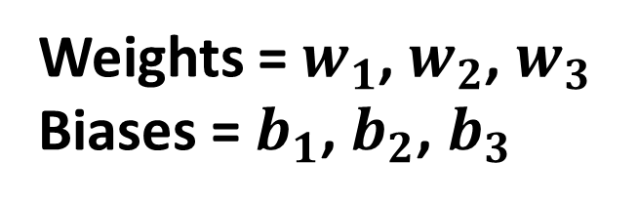


Example
$$w_{1}$$
$$w_{2}$$
$$w_{3}$$
Weights = $w_{1}$, $w_{2}$, $w_{3}$
Biases = $b_{1}$, $b_{2}$, $b_{3}$

Slide 8













Forward Pass
Desired output (y)
$$w_{3}$$
$$a_{2}$$
$$w_{1}$$
$$b_{3}$$
$$w_{2}$$
$$w_{3}$$
1.00
$$z_{3}$$
$$z_{3}=w_{3}a_{2}+b_{3}$$
$$y$$
$$a_{3}$$
$$a_{3}=σ(z_{3})$$
$$C_{0}$$
$$C_{0} ={\left(a_{3} −y\right)}^{2}$$

Slide 9

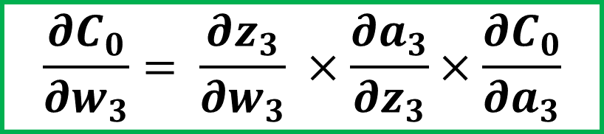


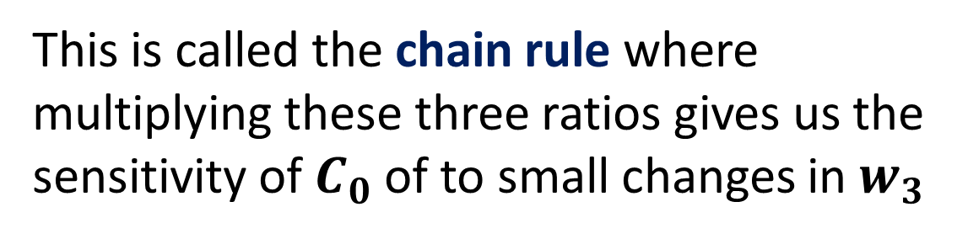




Chain Rule
$$w_{3}$$
$$a_{2}$$
$$b_{3}$$
Our first goal is to understand how sensitive the cost function is to small changes in our weight
$$z_{3}$$
$$\frac{∂C_{0}}{∂w_{3}}= \frac{∂z_{3}}{∂w_{3}} ×\frac{∂a_{3}}{∂z_{3}}×\frac{∂C_{0}}{∂a_{3}}$$
$$y$$
$$a_{3}$$
This is called the chain rule where multiplying these three ratios gives us the sensitivity of $C_{0}$of to small changes in $w_{3}$
$$C_{0}$$
Notes:
The derivative is a tool of calculus that quantifies the sensitivity of change of a functions output with respect to its input

Slide 10
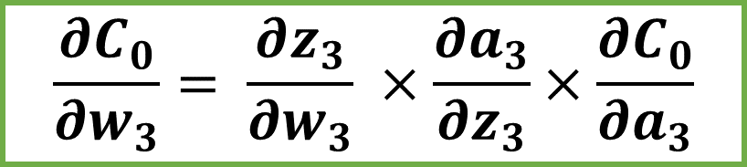
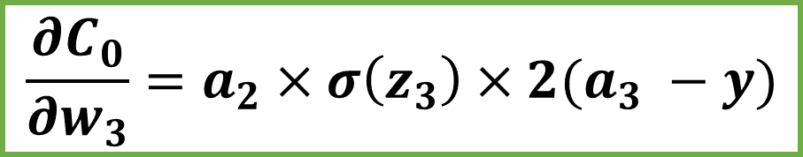
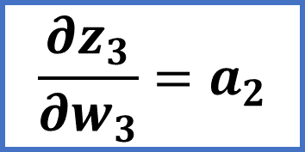
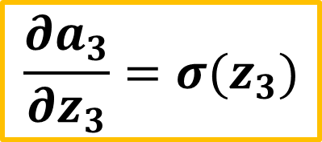
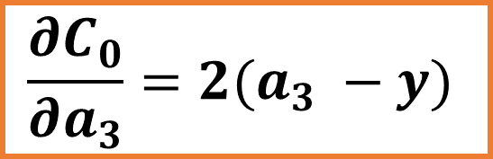
Chain Rule
$$\frac{∂C_{0}}{∂w_{3}}= \frac{∂z_{3}}{∂w_{3}} ×\frac{∂a_{3}}{∂z_{3}}×\frac{∂C_{0}}{∂a_{3}}$$
$$\frac{∂C_{0}}{∂a_{3}}=2(a_{3} −y)$$
$$\frac{∂a_{3}}{∂z_{3}}=σ(z_{3})$$
$$\frac{∂z_{3}}{∂w_{3}}=a_{2}$$
$$\frac{∂C_{0}}{∂w_{3}}=a_{2}×σ\left(z_{3}\right)×2(a_{3} −y)$$

Slide 11


Chain Rule
$$\frac{∂C_{0}}{∂w_{3}}=a_{2}×σ\left(z_{3}\right)×2(a_{3} −y)$$
This is only for one training example!
$$\frac{∂C}{∂w_{i}}= \frac{1}{n} \sum_{k=0}^{n −1}{\frac{∂C_{k}}{∂w_{i}}}$$
We need to average of all training examples

Slide 12
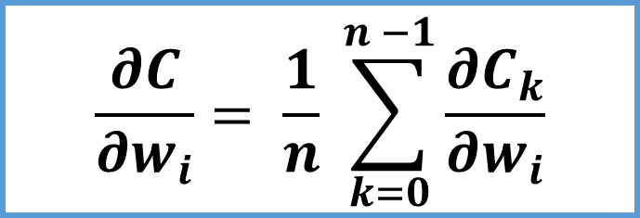
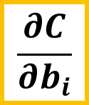

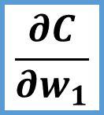
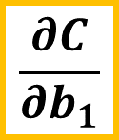
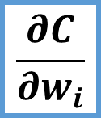
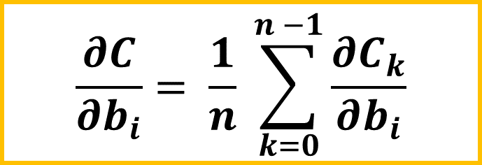
Gradient
$$\frac{∂C}{∂w_{1}}$$
$$\frac{∂C}{∂w_{i}}= \frac{1}{n} \sum_{k=0}^{n −1}{\frac{∂C_{k}}{∂w_{i}}}$$
$$\frac{∂C}{∂b_{1}}$$
$$∇C=$$
.
.
.
$$\frac{∂C}{∂b_{i}}= \frac{1}{n} \sum_{k=0}^{n −1}{\frac{∂C_{k}}{∂b_{i}}}$$
$$\frac{∂C}{∂w_{i}}$$
$$\frac{∂C}{∂b_{i}}$$
Notes:
The gradient gives the direction and the rate of of fastest increase

Slide 13
















Iterating the Chain rule
$$w_{2}$$
$$a_{1}$$
$$b_{2}$$
$$z_{2}$$
y
$$w_{2}$$
$$w_{3}$$
1.00
$$w_{3}$$
$$a_{2}$$
$$b_{3}$$
$$a_{1}$$
$$a_{2}$$
$$a_{3}$$
$$z_{3}$$
$$y$$
$$a_{3}$$
$$C_{0}$$

Slide 14
Back Propagation Example

Slide 15

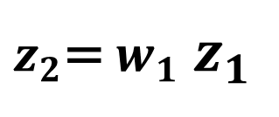


$$z_{1}$$
$$z_{2}$$
$$w_{1}$$
$z_{2}$= $w_{1}$ $z_{1}$

Slide 16

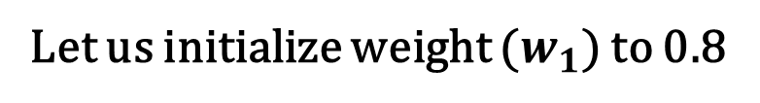
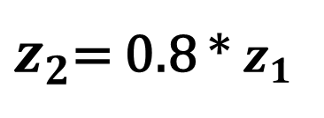

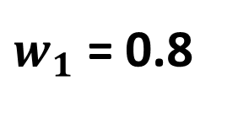
$$z_{1}$$
Let us initialize weight ($w_{1}$) to 0.8
$$z_{2}$$
$w_{1}$ = 0.8
$z_{2}$= 0.8 * $z_{1}$

Slide 17
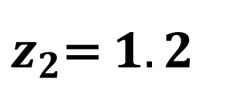

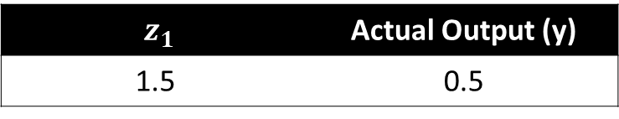
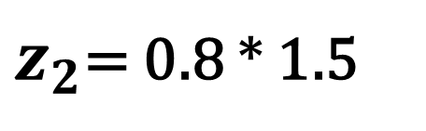

$z_{1}$ | Actual Output (y)
1.5 | 0.5
$$z_{1}$$
$$z_{2}$$
$w_{1}$ = 0.8
$z_{2}$= 0.8 * 1.5
$z_{2}$= $1.2$

Slide 18
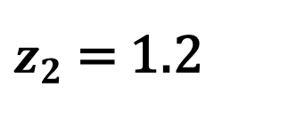

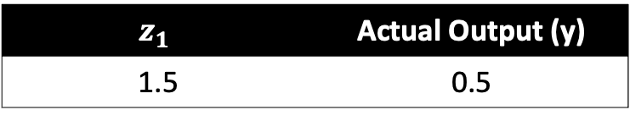
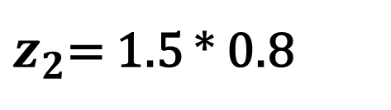

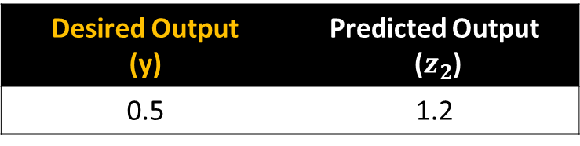
$$z_{1}$$ | Actual Output (y)
1.5 | 0.5
$$z_{1}$$
$$z_{2}$$
$w_{1}$ = 0.8
$z_{2}$= 1.5 * 0.8
$z_{2}$= 1.2
Desired Output (y) | Predicted Output ($z_{2}$)
0.5 | 1.2

Slide 19
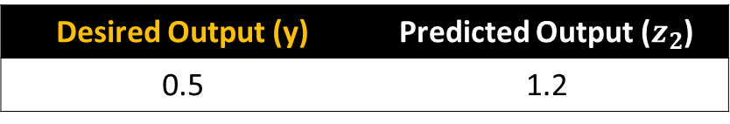

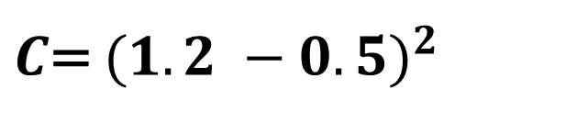
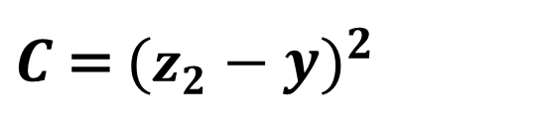
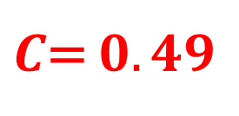
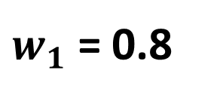
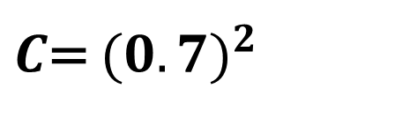
Let us use Mean Squared Error (MSE) as our cost function
Desired Output (y) | Predicted Output ($z_{2}$)
0.5 | 1.2
$$z_{1}$$
$$z_{2}$$
$w_{1}$ = 0.8
$C$ = ${(z_{2}−y)}^{2}$
$C$= ${(1.2 −0.5)}^{2}$
$C$= ${(0.7)}^{2}$
$C$= $0.49$

Slide 20
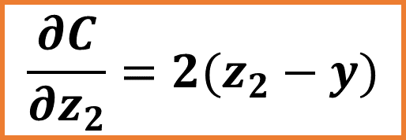
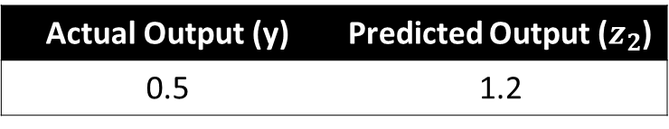
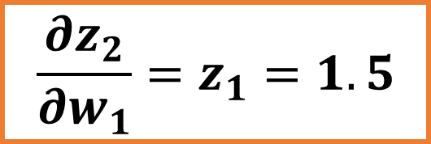
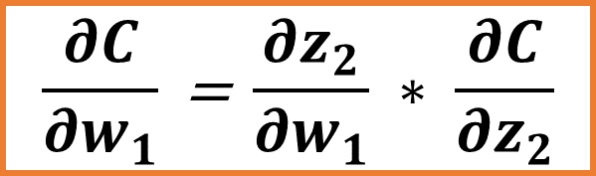
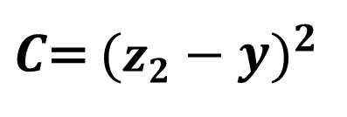
Actual Output (y) | Predicted Output ($z_{2}$)
0.5 | 1.2
$C$= ${(z_{2}−y)}^{2}$
Actual Output (y)
$$\frac{∂C}{∂w_{1}}\text{ = }\frac{∂z_{2}}{∂w_{1}} ∗ \frac{∂C}{∂z_{2}}$$
$$\frac{∂z_{2}}{∂w_{1}}=z_{1}=1.5$$
Weight
$$\frac{∂C}{∂z_{2}}=2(z_{2}−y)$$

Slide 21
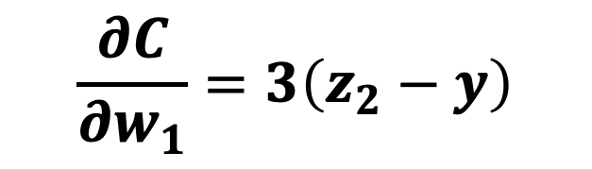
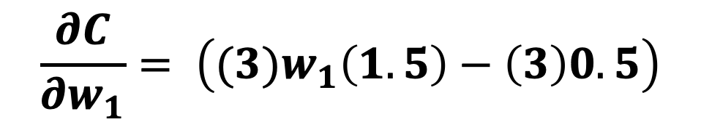
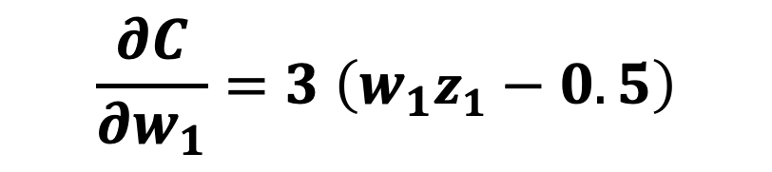
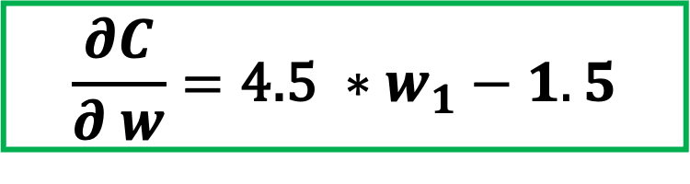
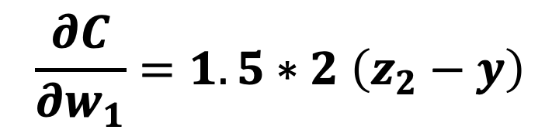
$$\frac{∂C}{∂w_{1}}=1.5∗2 \left(z_{2}−y\right)$$
$$\frac{∂C}{∂w_{1}}=3\left(z_{2}−y\right)$$
Actual Output (y)
$$\frac{∂C}{∂w_{1}}=3 \left(w_{1}z_{1}−0.5\right)$$
$$\frac{∂C}{∂w_{1}}= \left({(3)w}_{1}\left(1.5\right)−\left(3\right)0.5\right)$$
Weight
$$\frac{∂C}{∂ w}=\text{4.5 }∗w_{1}−1.5$$

Slide 22
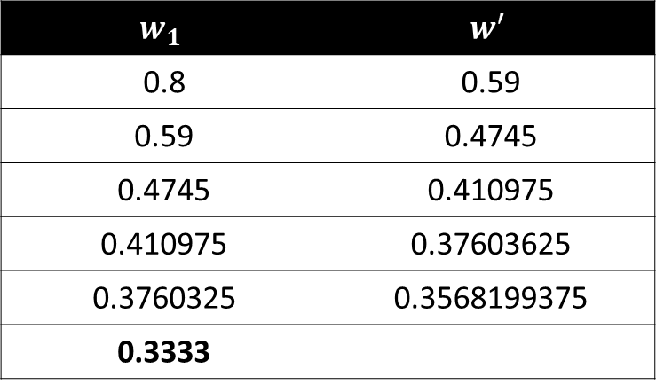
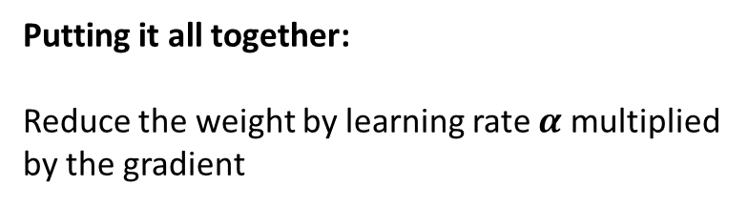
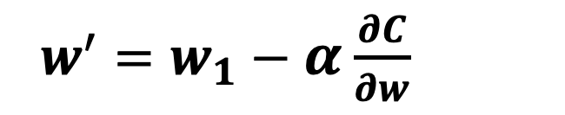
Putting it all together:
Reduce the weight by learning rate $α$ multiplied by the gradient
$w^{′}=w_{1}−α$ $\frac{∂C}{∂w}$
Actual Output (y)
$$w^{′}=w_{1}−0.1∗(4.5w_{1}−1.5)$$
$$w_{1}$$ | $$w^{′}$$
0.8 | 0.59
0.59 | 0.4745
0.4745 | 0.410975
0.410975 | 0.37603625
0.3760325 | 0.3568199375
0.3333
Weight

